Slide 1



University Mis

Slide 2

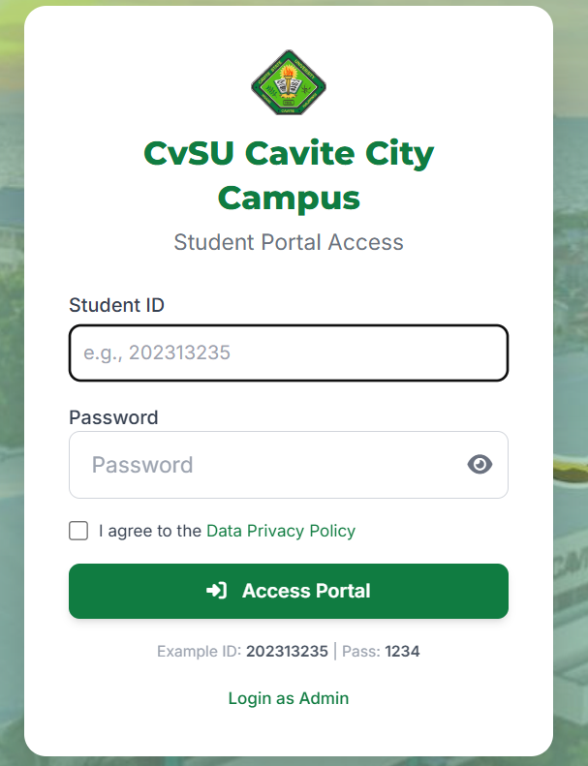
Description
The CVSU Student Portal is a web-based information system designed to provide students and administrators with a centralized platform for accessing academic-related information. The system supports role-based access to ensure that each user can only access features relevant to their role.
This project aims to improve efficiency in managing student records, announcements, and academic data by digitizing manual processes.

Slide 3

Primary Objectives
Provide students easy access to their academic information with an improved User Interface of the system
01
02
Improve communication through announcements
03
Enable profile and account management
To ensure secure and role-based access to system features
04

Slide 4
Requirements Gathering
‎Student Portal Management Information System (MIS) requirements gathering is a critical initial phase in system development, aiming to define the system's goals, scope, and detailed functionalities. ‎
‎Key Steps in Requirements Gathering ‎ ‎
1. Define Objectives and Scope: Clearly articulate what the Student Portal MIS is intended to achieve. ‎ ‎
2. Identify Stakeholders: ‎ ‎ - Students ‎ ‎ - Administrative Staff ‎ ‎
‎3. Elicitation Techniques ‎ - Observation/Shadowing ‎ - Surveys ‎
4. Analysis and Documentation ‎ ‎
5. Validation and Verification

Slide 5
Requirements Analysis
Summary of Requirements Derived from the Survey
Based on the survey results, the following requirements were identified:
Functional Requirements:
Online access to student information
Profile editing and personal information updates
Password change and reset functionality
Announcement display upon portal access
Non-Functional Requirements:
User-friendly and visually appealing interface
System reliability
Improved security and data protection

Slide 6
system features (flow of the system)
User logs in to the system
System detects user role (Student or Admin)
User is redirected to the correct dashboard
User accesses system modules
System retrieves and processes data
System updates records in the database
System displays updated information to the user
System sends notifications when needed
User logs out securely

Slide 7
Student Features & Flow
Admin Features & Flow
Student Functions
Edit Information and Change Password
View announcements and academic calendar
View class schedule
View grades and computed GWA
View billing statements
View registration form
Flow
Student logs in → selects module → system displays data
Admin Functions
Post announcements and calendar events
Manage student academic information
Create schedules and assign subjects
Input and update grades
Generate billing statements
Flow
Admin inputs data → system validates → data is saved

Slide 8
System Automated Processes
System Responsibilities
Sends announcement to students
Automatically computes GWA
Validates and secures data
Stores records in the database

Slide 9
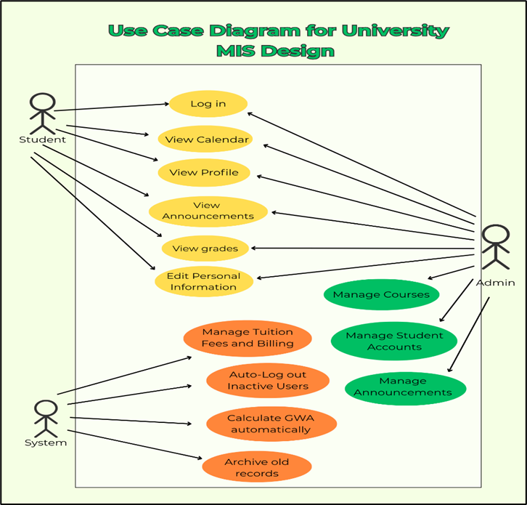
use case diagram

Slide 10
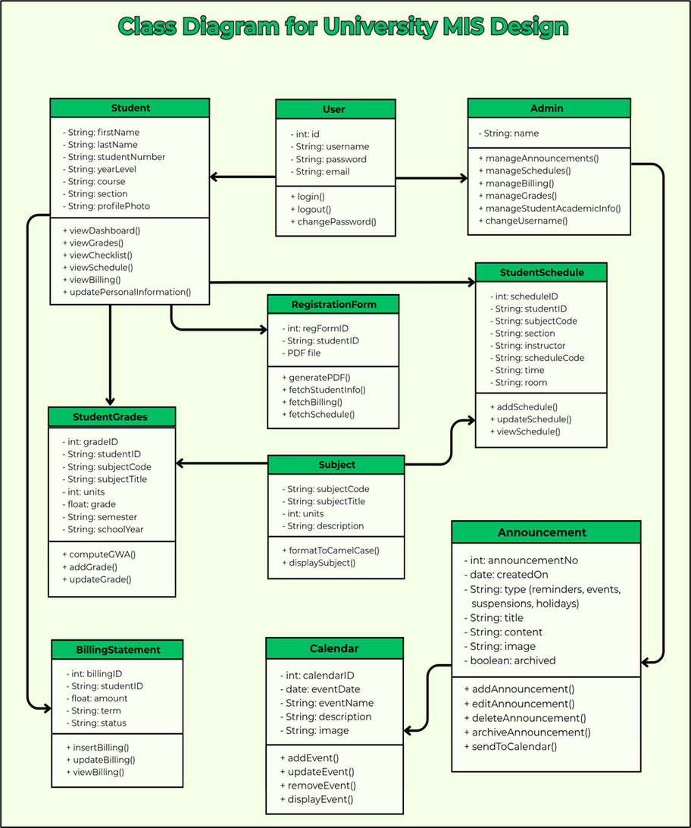
class
diagram

Slide 11
Thank You
Agedio, Railey Mae D.
Balicat, Althea
Diaz, Florence Sophia V.
Estores, Aicee Emari H.
Ornales, Alexis F.

